Slide 1


API Design
Intro to APIs – Class 10

Slide 2


what Is api design, anyway?
API design is the collection of planning and architectural decisions you make when building an API. Your basic API design influences how well developers are able to consume it, and even how they use it. Just like website design or product design, API design informs the user experience.

Slide 3

some basic guidelines for your api…
Implement pagination into large datasets from the beginning (if applicable), even if it isn’t required on day one. If a GET call returns a list of data that may eventually grow so large that you might need to paginate it, even if you don’t need the pagination now, implement it from the get-go. And subsequently, when you’re implementing pagination, return the total count in every response — don’t make the consumer keep requesting additional pages until they no longer get the proper data back.
Use proper HTTP methods and don’t let invocations have unforeseen side effects. For example, ensure that a GET request isn’t actually mutating the data. Use proper REST/HTTP best practices and ensure that your API aligns with what all developers (besides yourself) would expect when hitting that endpoint.
Use standard ISO (International Organization for Standardization) dates. This might seem super simple, but unfortunately, it is far too common that dates are implemented in multiple ways across different sets of APIs. Use standard ISO date formats and remove the work for downstream consumers. Use a “liberal input, strict output” approach and accept input dates in multiple standard formats.
Use static contracts. Developers love known entities and despise unforeseen unknowns. Thus, don’t make it so that API response formats differ based on statuses or results. For example, fields that don’t apply should be sent back as null. Be conscious to not let your input API break on absence of optional fields. Adopt a similar “liberal input, strict output” approach. Make sure that no matter what happens, the user gets a response that matches his or her contract. If you catch an exception, don’t return a 500 with a stack-trace dump. Instead, return a 500 with a proper JSON object that indicates the error.

Slide 4
Avoid inconsistent data models across different endpoints. As an example, a Customer record in one endpoint should look like a Customer record in adjacent endpoints. Don’t allow your models to be different because this will surely confuse the developers who consume your API. Be pragmatic and sensitive in cases where service-read clients require tabular formats and use a separate “R” service when CQRS (Command Query Responsibility Segregation) is not feasible.
CQRS is a popular architecture pattern because it addresses a common problem to most enterprise applications. Separating write behavior from read behavior, which the essence of the CQRS architectural pattern, provides stability and scalability to enterprise applications while also improving overall performance.
Use HTTP status codes correctly. Don’t bury the status of an API call in the body of an API response. Use proper HTTP status codes to report successes and failures. Return only 200-range status codes when an API call is truly successful. Return 500-range status codes when things have failed. Use a 202 status code for unknown or partial successes and a 206 for partially completed successes in more complex cases.
Leverage HTTP to maximize efficiency. Lean on HTTP mechanisms to identify ways to keep the communication chatter between client and server to a minimum. As an example, use PATCH for partial updates and don’t return an entire object if only a single field has been updated. Also, implement conditional GET availability to help consumers determine if a resource has been updated since the last time they fetched it. Look to leverage the HEAD method as an economical alternative to GET for scenarios wherein the user just needs to know if resource exists. Also, provide optional filters so that GET reduces the size of the output and server processing time, if possible.
Have your APIs properly documented and provide sample responses for all endpoints. We’ll end with one that seems like a no-brainer, and yet far too often API consumers are left to guess or trial and error how to best understand an API due to an absence of proper documentation.
some basic guidelines for your api…

Slide 5
what is good api design?
Easy to read and work with: A well-designed API will be easy to work with, and its resources and associated operations can quickly be memorized by developers who work with it constantly.
Hard to misuse: Implementing and integrating with an API with good design will be a straightforward process, and writing incorrect code will be a less likely outcome. It has informative feedback, and doesn’t enforce strict guidelines on the API’s end consumer.
Complete and concise: Finally, a complete API will make it possible for developers to make full- fledged applications against the data you expose. Completeness happens over time usually, and most API designers and developers incrementally build on top of existing APIs. It is an ideal which every engineer or company with an API must strive towards.

Slide 6


what about API Architecture?
An API’s architecture consists of the rules that guide what information an API can share with clients and how it shares the data. REST and SOAP are the most popular API architectures/architecture-dependent protocols in use today — let’s unpack each of these in more detail.

Slide 7
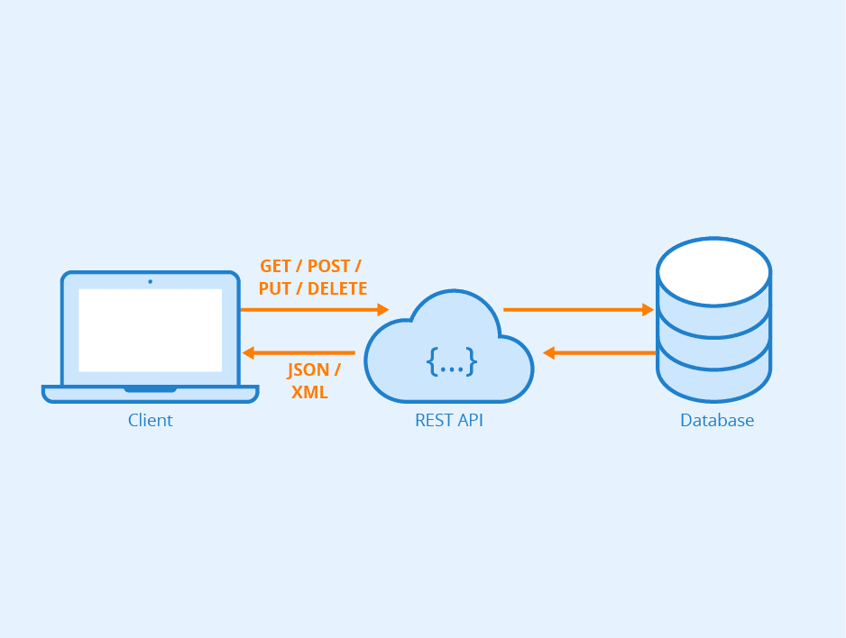
REST Apis
A REST API (also known as RESTful API) is an application programming interface (API or web API) that conforms to the constraints of REST architectural style and allows for interaction with RESTful web services. REST stands for representational state transfer and was created by computer scientist Roy Fielding.
REST is a set of architectural constraints, not a protocol or a standard. API developers can implement REST in a variety of ways.
When a client request is made via a RESTful API, it transfers a representation of the state of the resource to the requester or endpoint. This information, or representation, is delivered in one of several formats via HTTP: JSON (Javascript Object Notation), HTML, XLT, Python, PHP, or plain text. JSON is the most generally popular file format to use because, despite its name, it’s language-agnostic, as well as readable by both humans and machines.

Slide 8
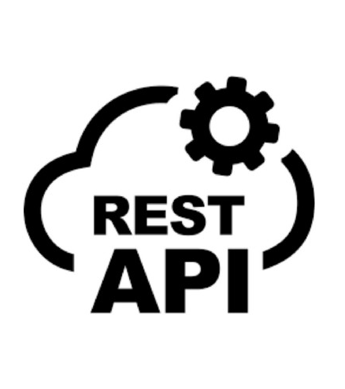
In order for an API to be considered RESTful, it has to conform to these criteria:
A client-server architecture made up of clients, servers, and resources, with requests managed through HTTP.
Stateless client-server communication, meaning no client information is stored between get requests and each request is separate and unconnected. A RESTful web service should not keep a client state on the server.
Cacheable data that streamlines client-server interactions.
A cacheable response is an HTTP response that can be cached; it is stored to be retrieved and used later.
A uniform interface between components so that information is transferred in a standard form. This requires that:
Resources requested are identifiable and separate from the representations sent to the client.
Resources can be manipulated by the client via the representation they receive because the representation contains enough information to do so.
Self-descriptive messages returned to the client have enough information to describe how the client should process it.
A layered system that organizes each type of server (those responsible for security, load-balancing, etc.) involved the retrieval of requested information into hierarchies, invisible to the client.
Code on demand. Most of the time, a server will send back static representations of resources in the form of XML or JSON. However, when necessary, servers can send executable code to the client.

Slide 9
rest api best practices
Use JSON as the format for sending and receiving data. In the past, accepting and responding to API requests were done mostly in XML and even HTML. But these days, JSON has largely become the de-facto format for sending and receiving API data. With XML, for example, it's often a bit of a hassle to decode and encode data, so it isn’t widely supported by frameworks anymore.
XML (Extensible Markup Language) is a markup language similar to HTML, but without predefined tags to use. Instead, you define your own tags designed specifically for your needs. This is a powerful way to store data in a format that can be stored, searched, and shared.
Use nouns instead of verbs in endpoints. The endpoints should use nouns, signifying what each of them does. This is because HTTP methods such as GET, POST, PUT, PATCH, and DELETE are already in verb form for performing basic CRUD (Create, Read, Update, Delete) operations. For example, an endpoint should not look like this: https://mysite.com/getPosts or https://mysite.com/createPost Instead, it should be something like this: https://mysite.com/posts

Slide 10
rest api best practices
Name collections with plural nouns. You can think of the data of your API as a collection of different resources from your consumers. If you have an endpoint like https://mysite.com/post/123, it might be okay for deleting a post with a DELETE request or updating a post with PUT or PATCH request, but it doesn’t tell the user that there could be some other posts in the collection. This is why your collections should use plural nouns. So, instead of https://mysite.com/post/123 it should be https://mysite.com/posts/123
Use nesting on endpoints to show relationships. Oftentimes, different endpoints can be interlinked, so you should nest them so it's easier to understand them. For example, in the case of a multi-user blogging platform, different posts could be written by different authors, so an endpoint such as https://mysite.com/posts/author would make a valid nesting in this case. In the same vein, the posts might have their individual comments, so to retrieve the comments, an endpoint like https://mysite.com/posts/postId/comments would make sense.
Use SSL for security. Remember, SSL stands for secure socket layer. It is crucial for security in REST API design. This will secure your API and make it less vulnerable to malicious attacks. The clear difference between the URL of a REST API that runs over SSL and the one which does not is the “s” after HTTP: https://mysite.com/posts runs on SSL, while http://mysite.com/posts does not run on SSL. (We’ll dive deeper into security during our API security lecture.)

Slide 11
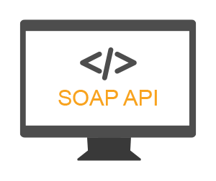
soap Apis
Simple Object Access Protocol (SOAP) is a message specification (protocol) for exchanging information between systems and applications. Think of SOAP as being like the national postal service; it provides a reliable and trusted way to send and receive messages between systems (and within enterprise applications). It is older, established, and dependable—but it can be slower than competing architectural styles like REST.
SOAP was a standard that emerged in the late 1990s to give businesses the ability to move data around between corporate networks. It was introduced just as the web was maturing, and while it does use HTTP primarily as a transport for the messages being passed around, its architectural patterns are not as closely aligned with HTTP as REST; SOAP can also employ other protocols.

Slide 12

SOAP uses XML as the data format for messages being sent and received by an API client, and it provides four distinct dimensions to the API protocol:
Envelope: Defining the structure of the message.
Encoding: Rules for expressing the type of data.
Requests: How each SOAP API request is structured.
Responses: How each SOAP API response is structured.
Even though SOAP is very strict in its implementation guidelines, it is also known for being extensible. SOAP allows the structure of messages to be augmented and evolved to meet specific requirements. Like other approaches to delivering APIs, SOAP uses HTTP as a transport, but one of its strengths is that it can also leverage simple mail transport protocol (SMTP), transmission control protocol (TCP), and user data protocol (UDP) to pass messages back and forth. This allows for more flexibility when it comes to moving data, content, and media systems and applications.

Slide 13

SMTP?
SMTP (Simple Mail Transfer Protocol) is an email protocol used for sending email messages from one email account to another via the internet.
Email protocols are sets of rules that let different email clients and accounts easily exchange information, and SMTP is one of the most common ones. It is also the only dedicated protocol for sending emails. Most email clients—including Outlook, Apple Mail, Gmail, and Yahoo Mail—rely on SMTP to “push” or send messages from a sender to a recipient.

Slide 14
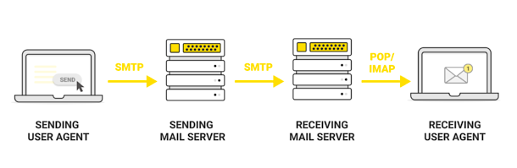
how does smTp work?
Once an SMTP server is established, email clients can connect to and communicate with it. When the user hits “send” on an email message, the email client opens an SMTP connection to the server so it can send. (The SMTP connection is built on a TCP connection– remember, it stands for Transmission Control Protocol.)
From there, the SMTP client uses commands to tell the server what to do and transfer data, like the sender’s email address, the recipient’s email address, and the email’s content. The Mail Transfer Agent or Message Transfer Agent (MTA) checks to see if both email addresses are from the same email domain, such as gmail.com:
If they are, it sends the email right away.
If not, the server uses the Domain Name System (DNS) to identify the recipient’s domain and then send it to the right server.
* POP (Post Office Protocol, latest version is POP3) and IMAP (Internet Message Access Protocol) are the other two most common email protocols in use.
The main difference between these protocols is that SMTP is the only protocol for sending or “pushing” email from one unknown mail server to another. POP and IMAP are protocols for receiving or “pulling” mail for the recipient from their own mail server.

Slide 15
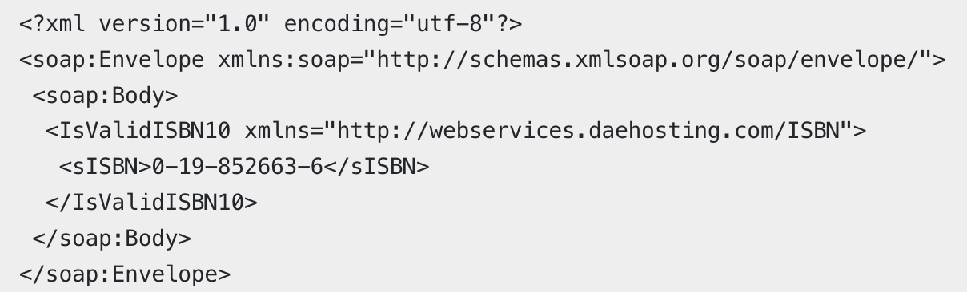
soap api example
Let’s take a look at an example of a SOAP API in an ISBN (International Standard Book Number) validation service, which provides validation using a simple URL:
http://webservices.daehosting.com/services/isbnservice.wso
This ISBN validation service uses a POST HTTP method to pass the following structured snippet of XML to the service using the body of the HTTP request. It provides a structured request for the server to process and return a response:

Slide 16
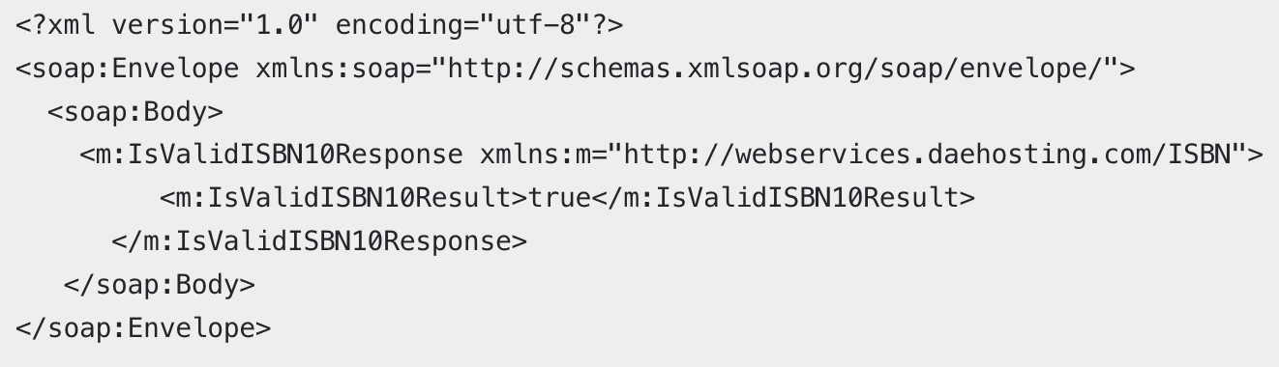
soap api example
This then returns the following XML response, which confirms that the ISBN number is valid:

Slide 17
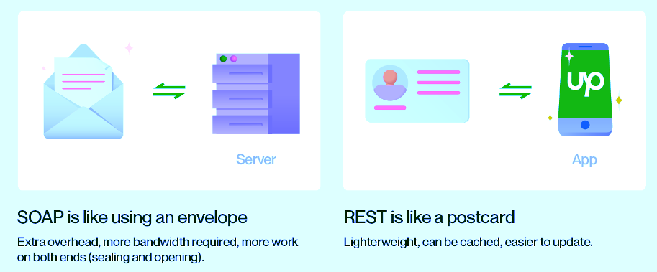

Slide 18

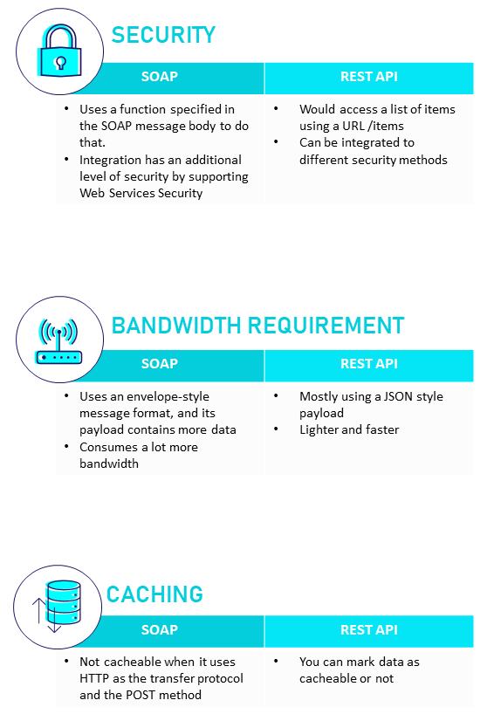

Slide 19
To be specific, REST is an architectural style, and SOAP is a protocol.

Slide 20

in-class discussion
What do YOU think is the most important part of API design? (Example: Returning accurate HTTP response codes.)
Why?

